Slide 1
Introduction to Text Mining/ Natural Language Processing (NLP)
Kip Sutter
Downtown Omaha Machine Learning Group
Sep 25th, 2019
Outline:
NLP Introduction
Key terms used in Natural language Processing
Is your name Male or Female? (Male/Female Classification)
Sentimental Analysis of Donald Trump Tweets
Topic “Theme” Modeling
https://www.meetup.com/Downtown-Omaha-Machine-Learning-Group/events/264459673/
Notes:
1
1

Slide 2
What is NLP
NLP is a branch of data science that consists of systematic processes for analyzing, understanding, and deriving information from the text data in a smart and efficient manner. By utilizing NLP and its components, one can organize the massive chunks of text data, perform numerous automated tasks and solve a wide range of problems such as :
Automatic summarization.
Machine translation
Named entity recognition
Relationship extraction
Sentiment analysis
Speech recognition
Topic segmentation etc
Resources to Learn NLP
NLTK: http://www.nltk.org/book/
A class: http://cs224d.stanford.edu/ by Manning : the best course
YouTube Playlist: https://www.youtube.com/watch?v=nfoudtpBV68&list=PL6397E4B26D00A269
Course: https://ocw.mit.edu/courses/electrical-engineering-and-computer-science/6-864-advanced-natural-language-processing-fall-2005/lecture-notes/
Others: https://www.quora.com/How-do-I-learn-Natural-Language-Processing
1

Slide 3
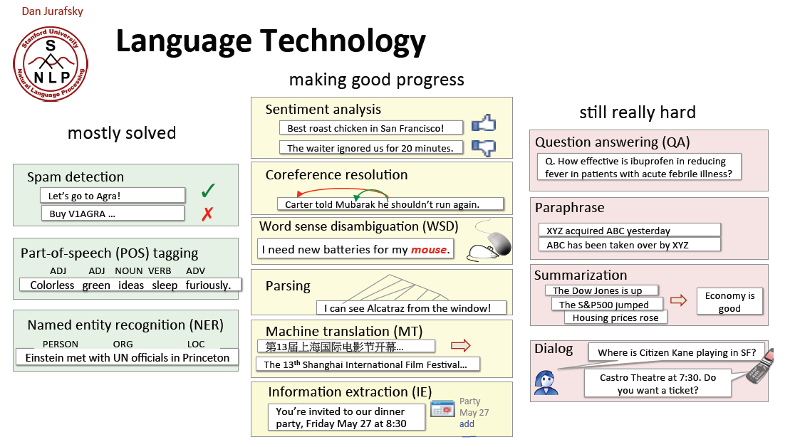
Some applications of NLP
Source: https://web.stanford.edu/~jurafsky/NLPCourseraSlides.html
1

Slide 4
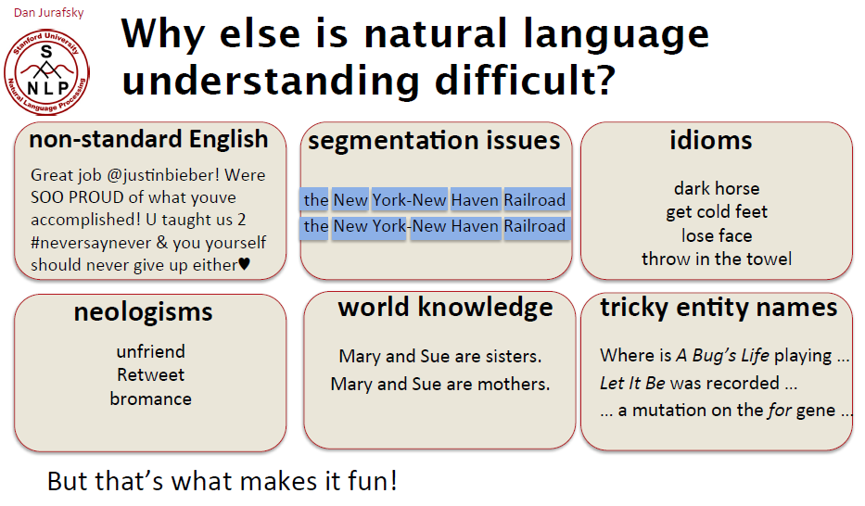
Challenges in NLP
In-law
Source: https://web.stanford.edu/~jurafsky/NLPCourseraSlides.html

Slide 5
Definition of Terms used in NLP
Tokens – words or entities present in the text
Tokenization – process of converting a text into tokens
N-grams – A contiguous sequence of n items from a given text or speech eg AGC, CGA (3-grams) , To be (2 grams) or New York (2 grams). A sequence of n-tokens.
N-gram model – Given a sequence of letters – what is the likelihood of the next letter? (uses: Spell correction, word breaking and text summarization.)
Parts-of-speech – Words can be analyzed into POS. Major lexical syntactic categories includes Noun, Verb, Adjective, Preposition
TF-IDF – Term Freq – Inverse Document Frequency – how important a word is to a doc
Corpus – Is a body of text. In Latin corpus means body. Corpora – collection of texts.
Synset – A set of one or more words considered to be synonyms in some or all contexts
Morphology —knowledge of the meaningful components of words
Syntax —knowledge of the structural relationships between words
Semantics —Study of linguistic meaning or knowledge of meaning
Pragmatics — knowledge of the relationship of meaning to the goals and intentions of the speaker
Discourse —knowledge about linguistic units larger than a single utterance
Ambiquity – A word or phrase or sentence conveys more than one meaning
Polysemy – Phenomenon of words having multiple meanings
Chunk – A sequence of words in text that constitute a non-recursive, elementary grouping of a particular syntactic category
Text object – a sentence or a phrase or a word or an article
1

Slide 6
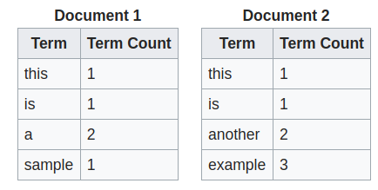
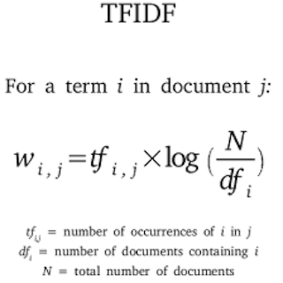
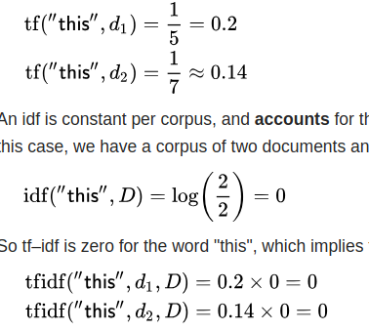
TF-IDF: Term frequency–inverse document frequency
TF-IDF is a numerical statistic that is intended to reflect how important a word is to a document in a collection or corpus.
1
Notes:
1
1

Slide 7
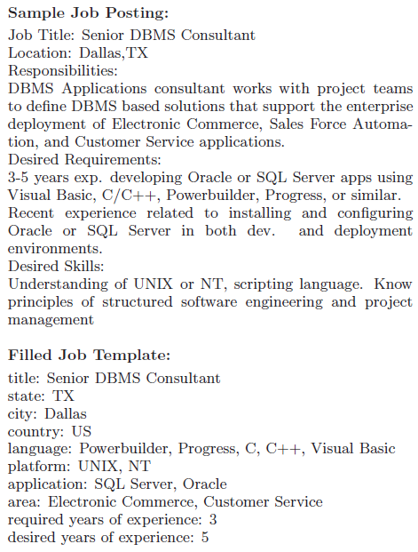
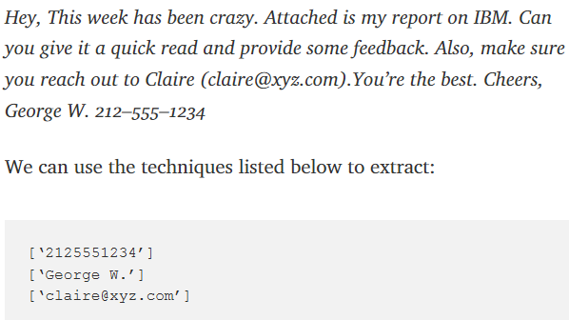
Data extraction
Goal: Derive from text assertions to store in a database
Example: SCISOR, Jacobs and Rau 1990
Summarizes Dow Jones News stories, and adds information to a database.
Populate database with info extracted from job advert.
Get phone #, names, email from text
Notes:
1
“Pillsbury surged 3 3-4 to 62 in big board composite trading of 3.1 million shares after Britain’s Grand Metropolitan raised its hostile tender offer by $3 a share to $63. The company promptly rejected the sweetened bid, which came after the two sides couldn’t agree to a higher offer on friendly terms over the weekend.”
Result:
Corp-Takeover-Core
Subevent: Increased Offer, Rejected Offer
Type: Hostile
Target: Pillsbury
Suitor: Grand Metropolitan
Share-Price: 63
Stock-Exchange NYSE
Volume 3.1M
Effect-On-Stock: (Up Increment : 3 3-4, to 62)
Reuters news does this

Slide 8
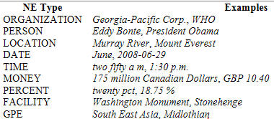
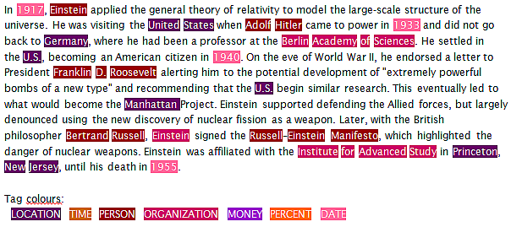
Named Entity Recognition(NER)/Extraction
Why NER?
Question Answering
Textual Entailment
Coreference Resolution
…
Example Text
1

Slide 9
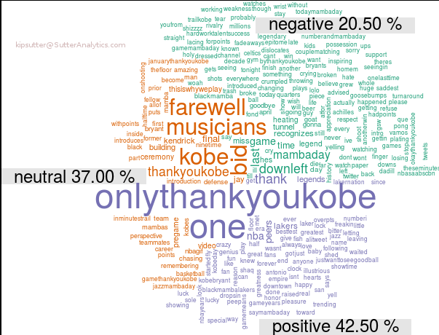
Sentimental analysis
How?
- Dictionary of words
- Rule based
- Sentiment Anal model (API)
1. Using a vocabulary: looking at important keywords (usually verbs and adjectives) along with modifiers like negation words 2. Using rules: look at presence of vocabulary words in sentences, use rules to categorize them by sentiment 2. Applying ML techniques: treat this as a classification problem, amass a dataset and set up features (which could be the keywords in the vocabulary), and train to identify sentiment.
Notes:
1

Slide 10
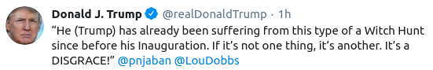
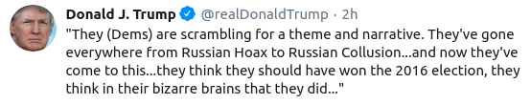
R DEMO Sentimental Analysis
@realDonaldTrump
1
Notes:
1
1

Slide 11
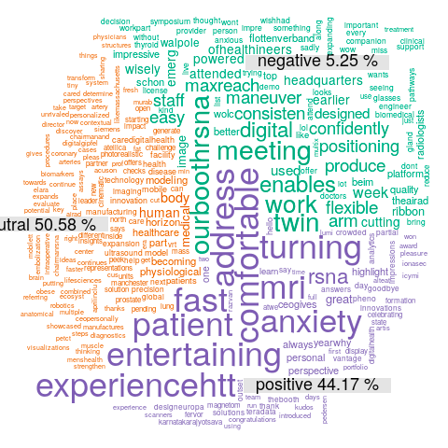
Sentimental analysis of @realDonaldTrump Tweets
Notes:
1

Slide 12
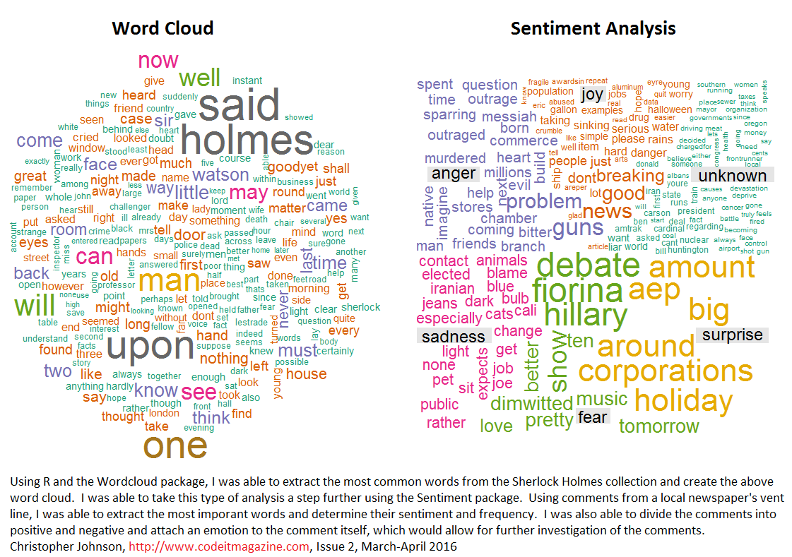
Sentimental analysis
Notes:
1

Slide 13
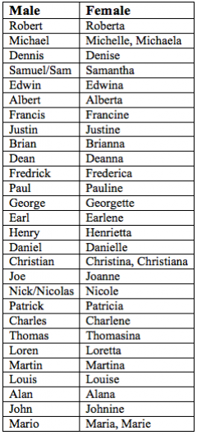
Python DEMO
Gender Identification
Company Confidential
1
Notes:
1
1

Slide 14
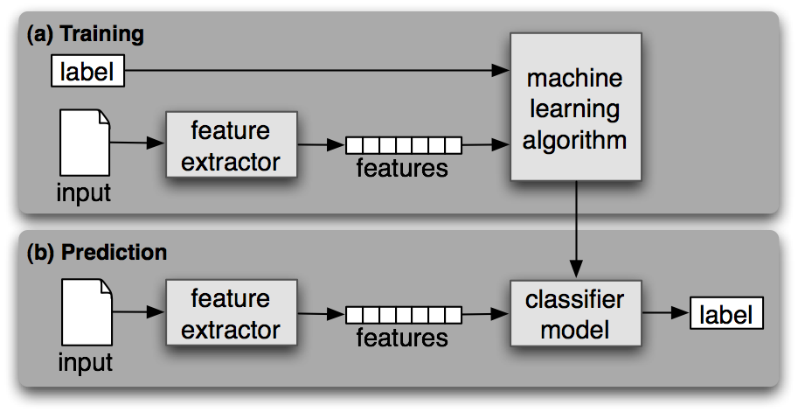
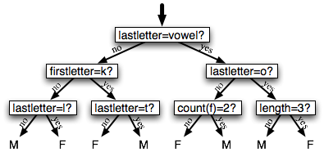
Gender Identification/Classification
Python DEMO
Gender Identification
Gender
M = Male
F = Female
Names ending in a, e and i are likely to be female, while names ending in k, o, r, s and t are likely to be male
Company Confidential
1
Notes:
1
1

Slide 15
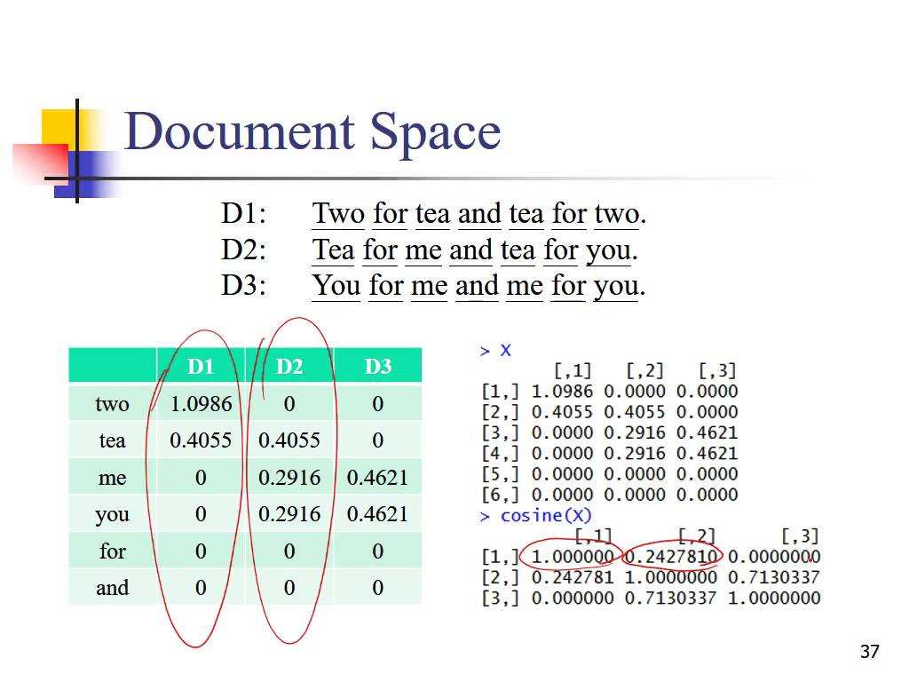
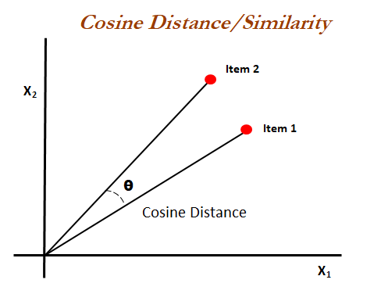
Cosine Similarity Toy Example
doc1
doc2
Cos O° deg = 1
Notes:
1

Slide 16
What is a Topic Model?
Intuition behind LDA
Latent Dirichlet Allocation
 | Topic 1 | Topic 2
Apple | 33% | 0%
Banana | 33% | 0%
Orange | 33% | 0%
Tiger | 0% | 33%
Cat | 0% | 33%
Dog | 0% | 33%
• doc1: apple banana
• doc2: apple orange
• doc3: banana orange
• doc4: tiger cat
• doc5: tiger dog
• doc6: cat dog
LDA
(2 topics)
 | Topic 1 | Topic 2
doc1 | 100% | 0%
doc2 | 100% | 0%
doc3 | 100% | 0%
doc4 | 0% | 100%
doc5 | 0% | 100%
doc6 | 0% | 100%
doc7 | 33% | 66%
A human will categorize:
Topic 1 = Fruits
Topic 2 = Animals
Input (what we have):
doc7: cat dog apple
The basic idea is that documents are represented as random mixtures over latent topics, where each topic is characterized by a distribution over words.
A document typically concerns multiple topics in different proportions; thus, in a document that is 10% about “Discrimination” and 90% about “Sales practices”, there would probably be about 9 times more “Sales practices”, words than “Discrimination” words
Notes:
1

Slide 17
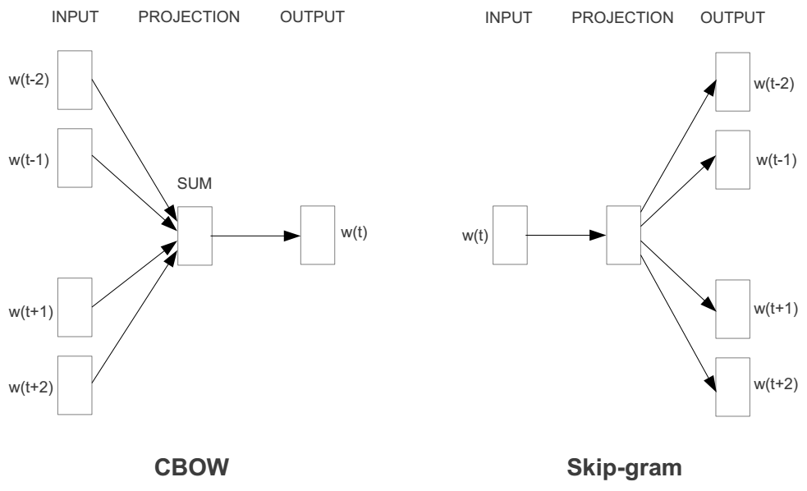
Word2vec - Represent the meaning of word
2 basic neural network models:
Continuous Bag of Word (CBOW): use a window of word to predict the middle word
Skip-gram (SG): use a word to predict the surrounding ones in window.
the
cat
Xxx?
on
floor
Word2vec is a group of related models that are used to produce word embeddings. These models are shallow, two-layer neural networks that are trained to reconstruct linguistic contexts of words.
1
Notes:
<number>

Slide 18
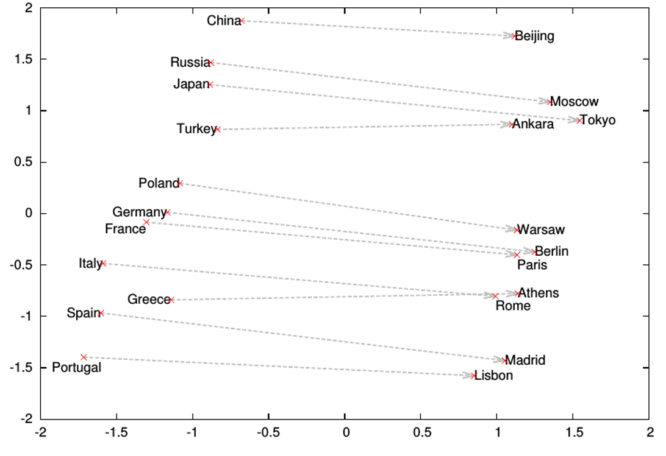
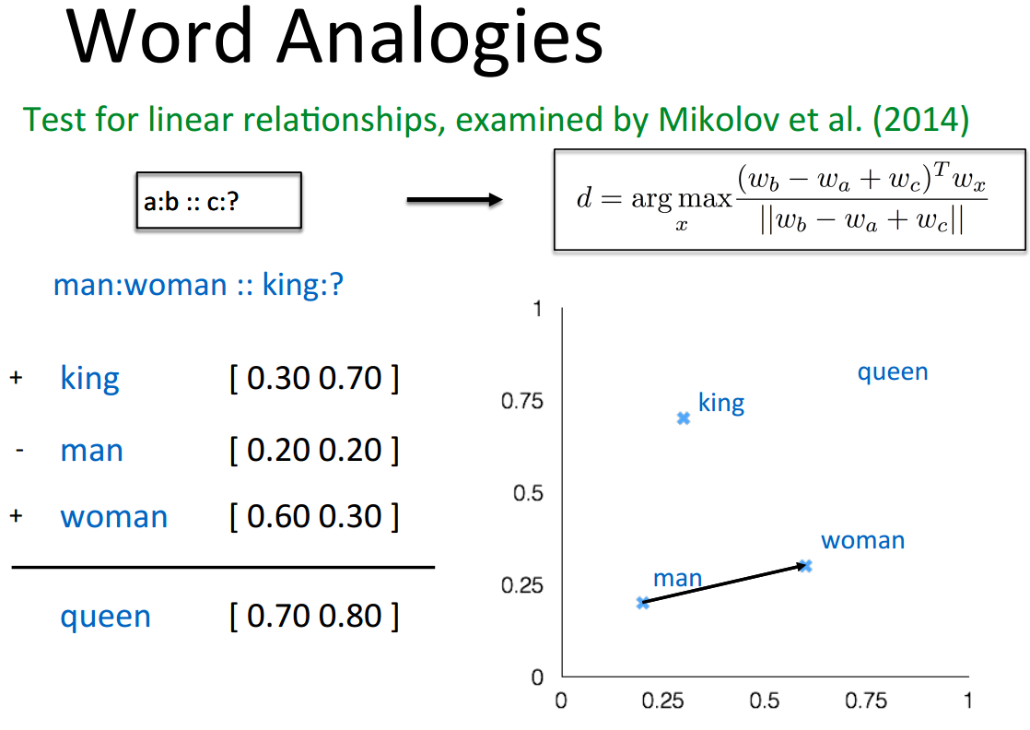
Some interesting results
Word analogies
1

Slide 19
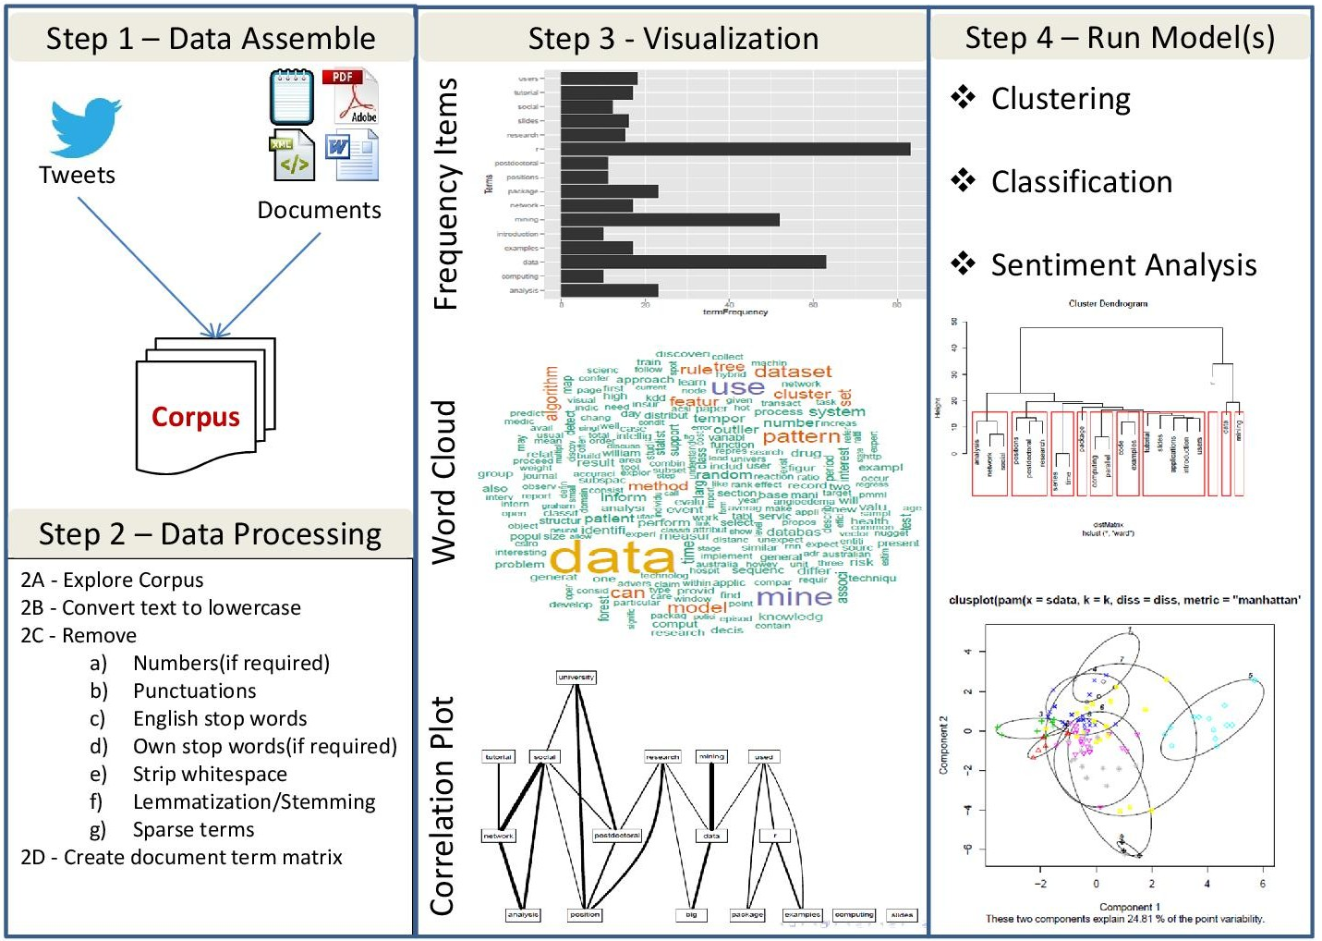
Conclusion
Company Confidential
1

Slide 20
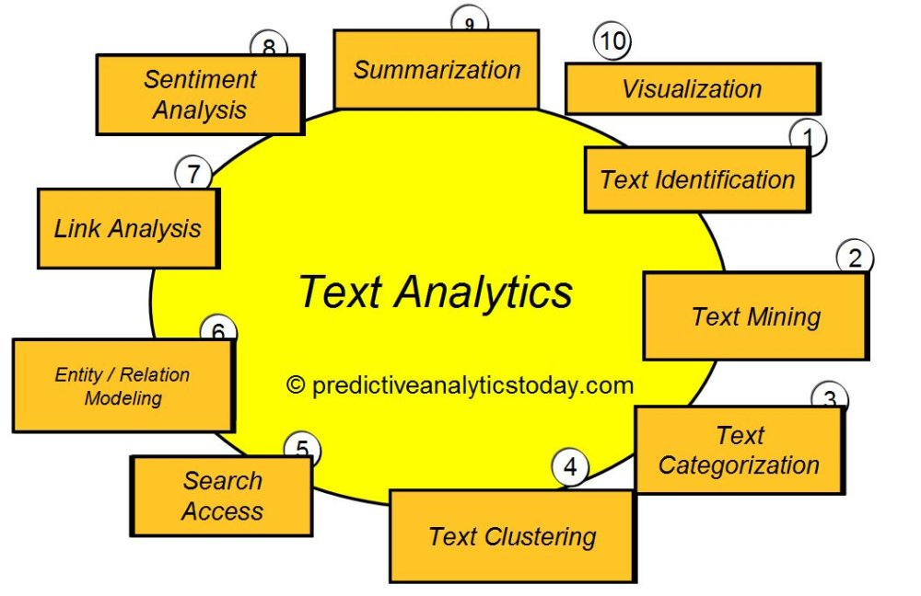
NLP Pipeline
1
Notes:
<number>
<number>

Slide 21
Questions?
Company Confidential
1
Notes:
<number>
<number>

Slide 22
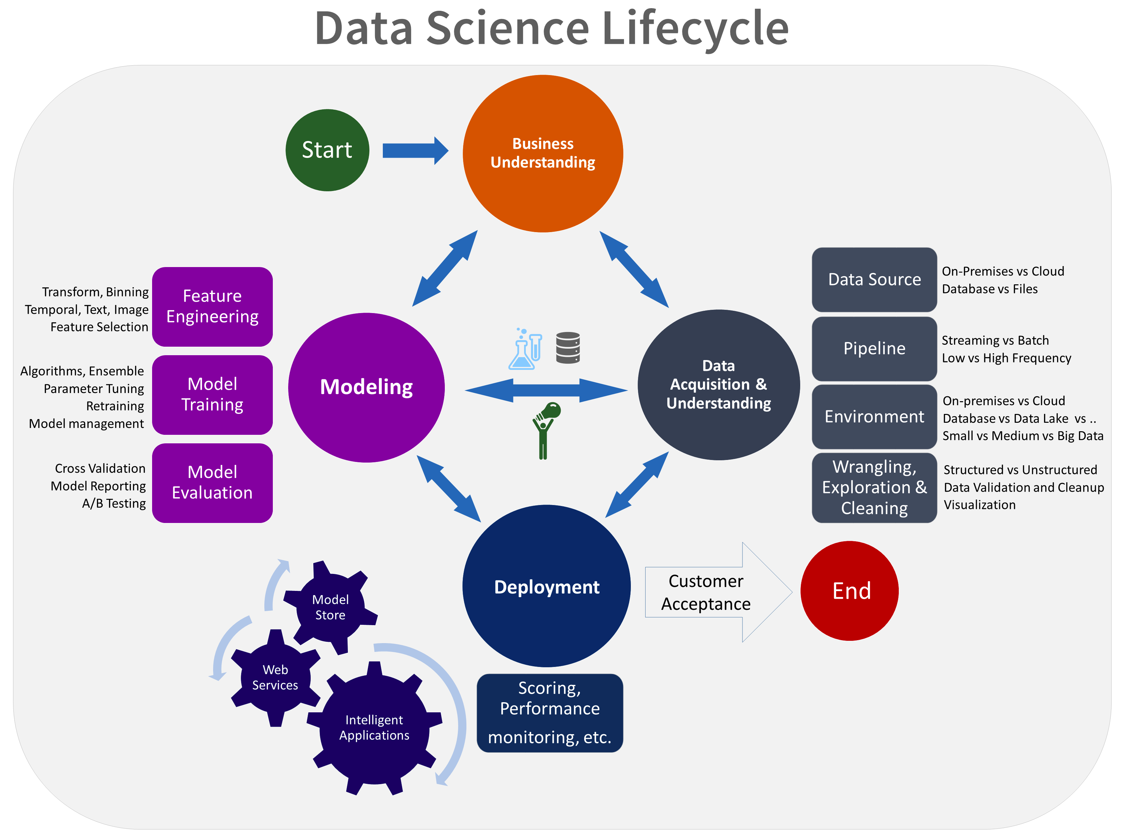
Machine Learning in brief
Company Confidential
1
Notes:
<number>
<number>

